Slide 1
Workshop 6
Matthew Thomas, Connor Quick, Benjamin Brown

Slide 2



Group Members
Matthew Thomas, Connor Quick, Ben Brown

Slide 3
What is Splunk?
Splunk can be used to filter many different types of data. This data can be used for Business Analytics, Security, and many more. Splunk provides tools to search through data, create reports and charts, create alerts and much more.

Slide 4
Adding data into Splunk
To begin, we will need to add our data into Splunk
An email has been sent with all the worksheets and data needed to complete this presentation
Notes:
https://www.splunk.com/en_us/download.html
Sign into Splunk
Left Side of Screen, Search and Reporting
Look for Add Data Icon and click on the icon
Upload
Select File
Access_30DAY.log
Sourcetype=access_combined_wcookies
Host field value = web_application

Slide 5
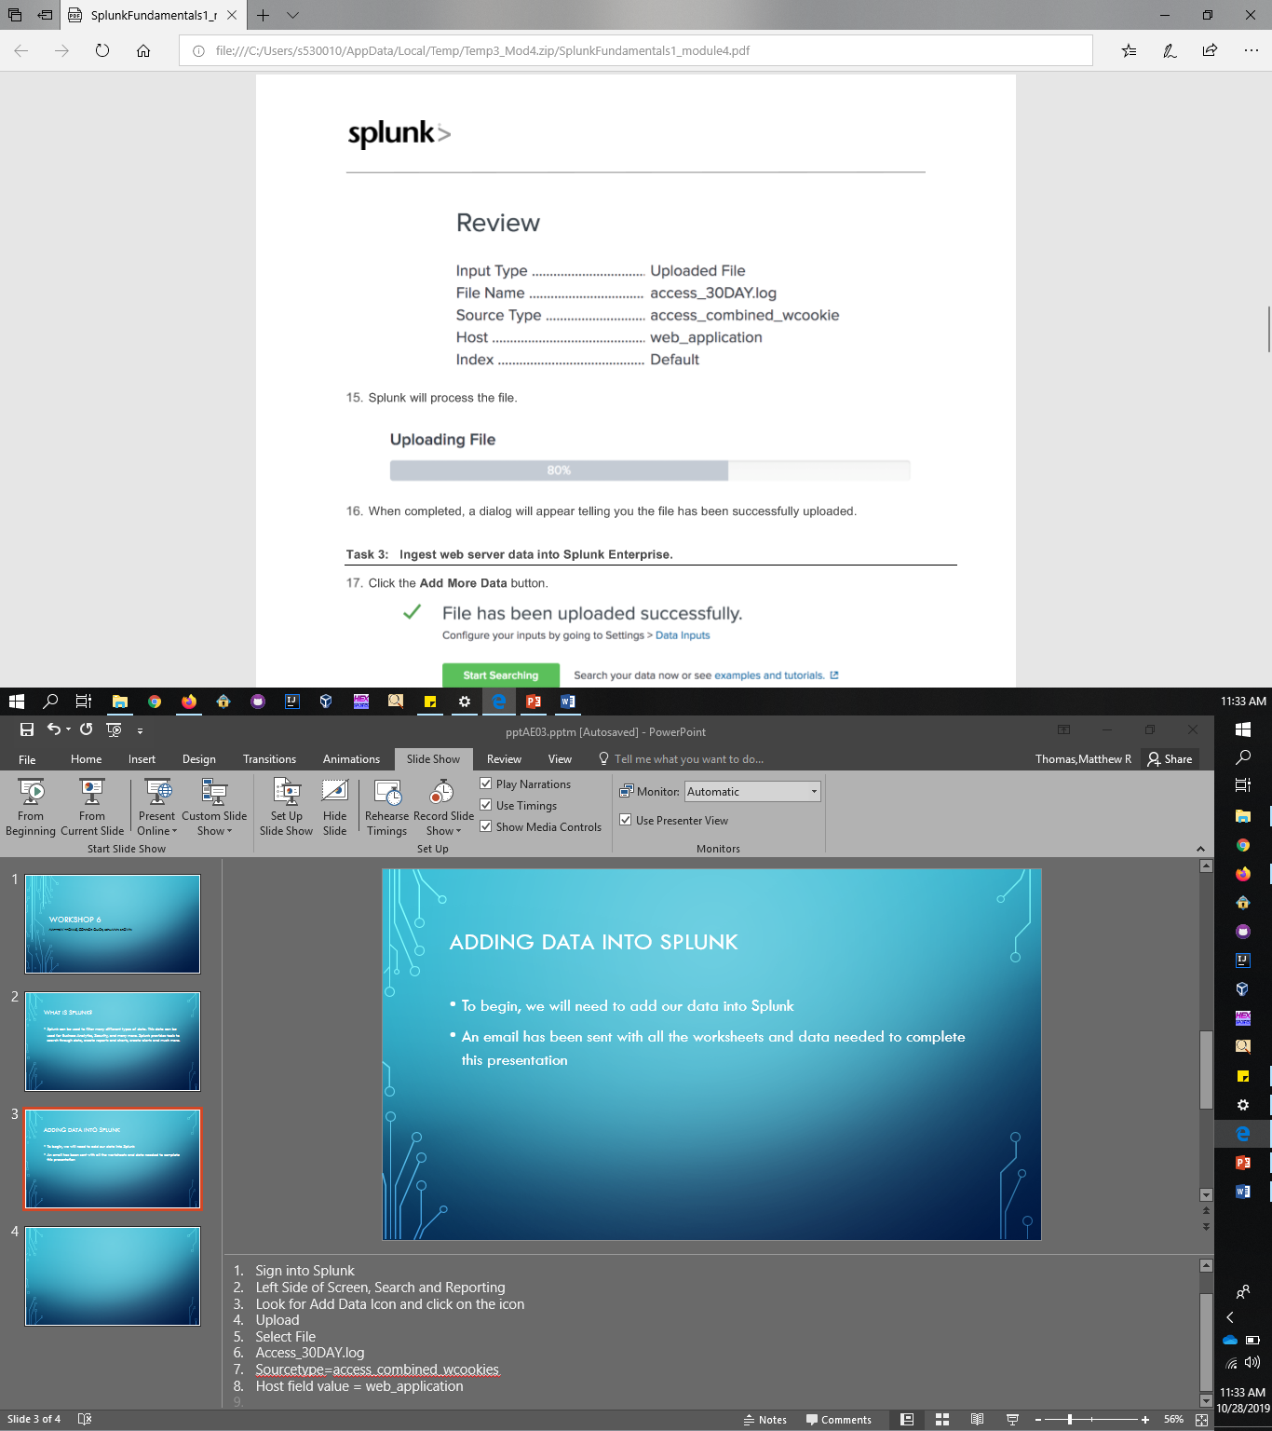
Review of Access_30DAY.log
Notes:
1. Add More Data
2. Select file – linux_s_30DAY.log
3. Source type is not correct
4. Set source type = linux_secure (in operating systems tab)
5. Host Field Value = web_server

Slide 6
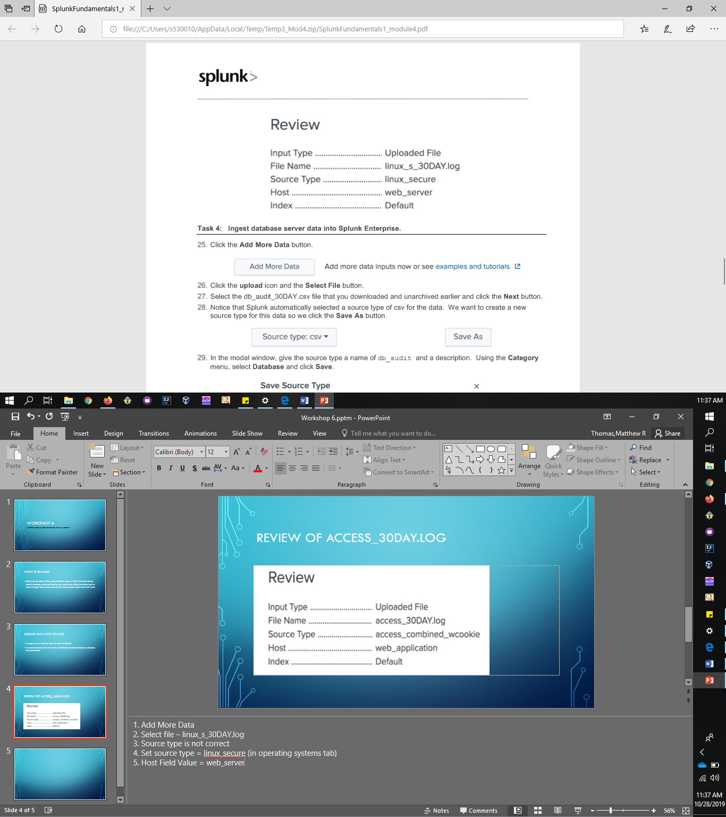
Review of Linux_s_30DAY.log
Notes:
Add more data
Source type = csv
Source type name = db_audit
Category Menu, select database
Host field value = database

Slide 7
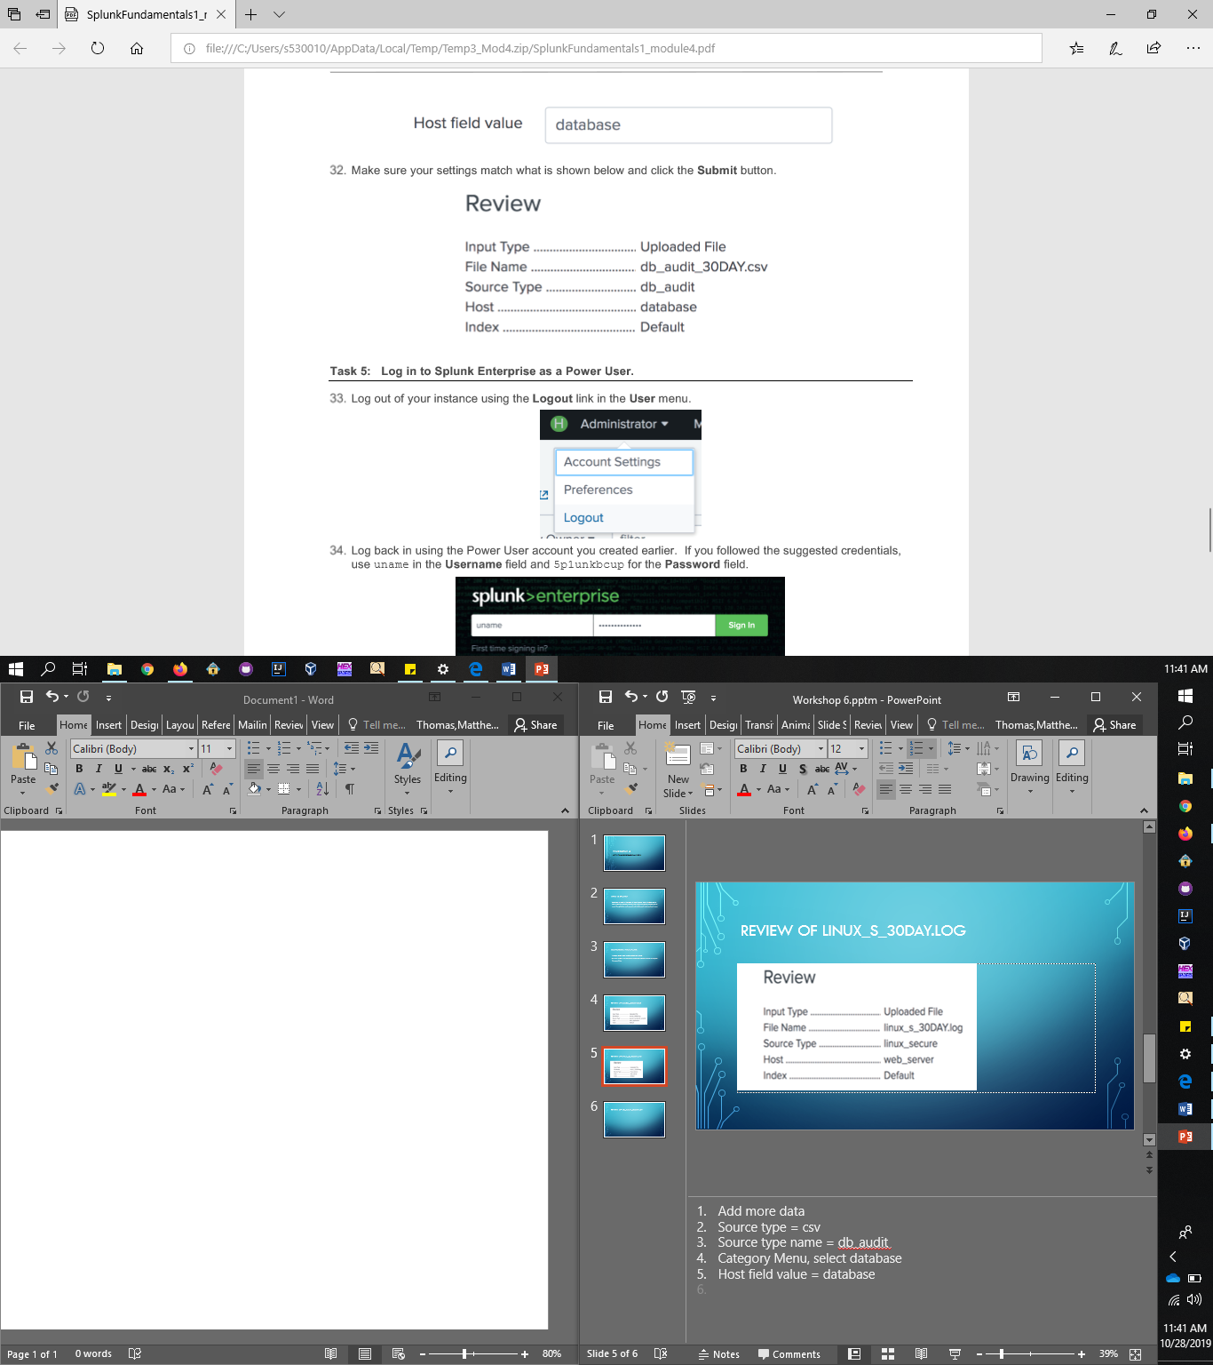
Review of db_audit_30DAY.csv

Slide 8
Searching DATA
We can now look into the data that we just added to our account
Searching will give you data such as failed passwords, invalid users, and much more!
Notes:
In the search bar, type error OR fail*
On the far right side of the screen you should see an option for range picker, make sure the range is set to all time
Click the search icon
We can see all the failed password attempts or errors while trying to connect to server
Now try fail* AND password
We want to see the attempts of connect to our open port 22
At the end of the search type “port 22” (quotations included)
If we see a trend in the data we can select certain words to add to search

Slide 9
Common Commads
Here is a list of common commands that you will use:
  Table
  Fields
  |
  Index
  Sourcetype
Top
Limit
Rare
Rename
Stats count … by …
Notes:
Start with “index=main sourcetype=access_combined_wcookies”
Table – lists the results in a table format
Fields – reduce the number of fields on the left side of the screen
| - used to create table and lists
Index- reduce the search results to a specific index
Sourcetype- reduces the search results to a specific sourcetype
Top- shows largest value first
Limit- limits the amount of data in a table to a specified number
Rare- shows values that occur least at the top of the table
Rename- renames a table value to specified
Stats count … by …- counts events

Slide 10
Reports and Dashboards
Splunk allows us to create reports, and allows use to create charts based on those reports
We are going to create a report based on Forbidden status 403
We then are going to create a dashboard based on successful purchases
Notes:
We will going into Search and Reporting
In the search bar type index=main sourcetype=access_combined_wcookies status=403
Turn search results into readable data by adding “| stats count as attempts by clientip”
We then want to sort the info, add “| sort –attempts”
Click the save as button which is located above the range picker
Select report and then enter a title of 403_by_clientip, then save
We want to again begin with the same index and sourcetype but then we want to file=success.do status=200
Sort the data by adding | stats count by productId
Then select the visualization tab, then select column chart
Click save as and select dashboard panel, dashboard title: sales dashboard; panel title: product sales
Click view dashboard
At the bottom of the chart there should be a magnifying glass, “open in search”, click that button
In the search field remove the by clause
Select Visualization tab, select single value
Save as Dashboard Panel
Panel title : Total Units Sold
View Dashboard

